Slide 1


Positive Analysis of Pigouvian Tax under Different Market Structures
Xingjian Angel Ren
Supervised by Dr. Bryan Buckley

Slide 2
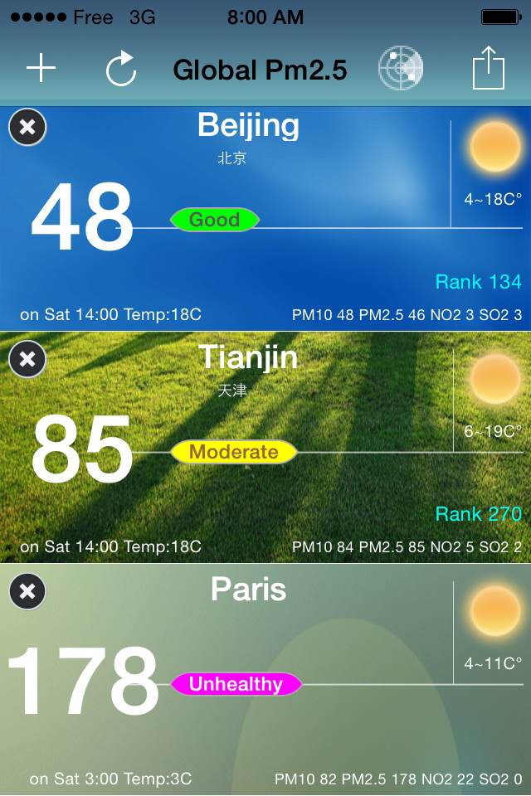
March 21st 2015
Paris, France

Slide 3
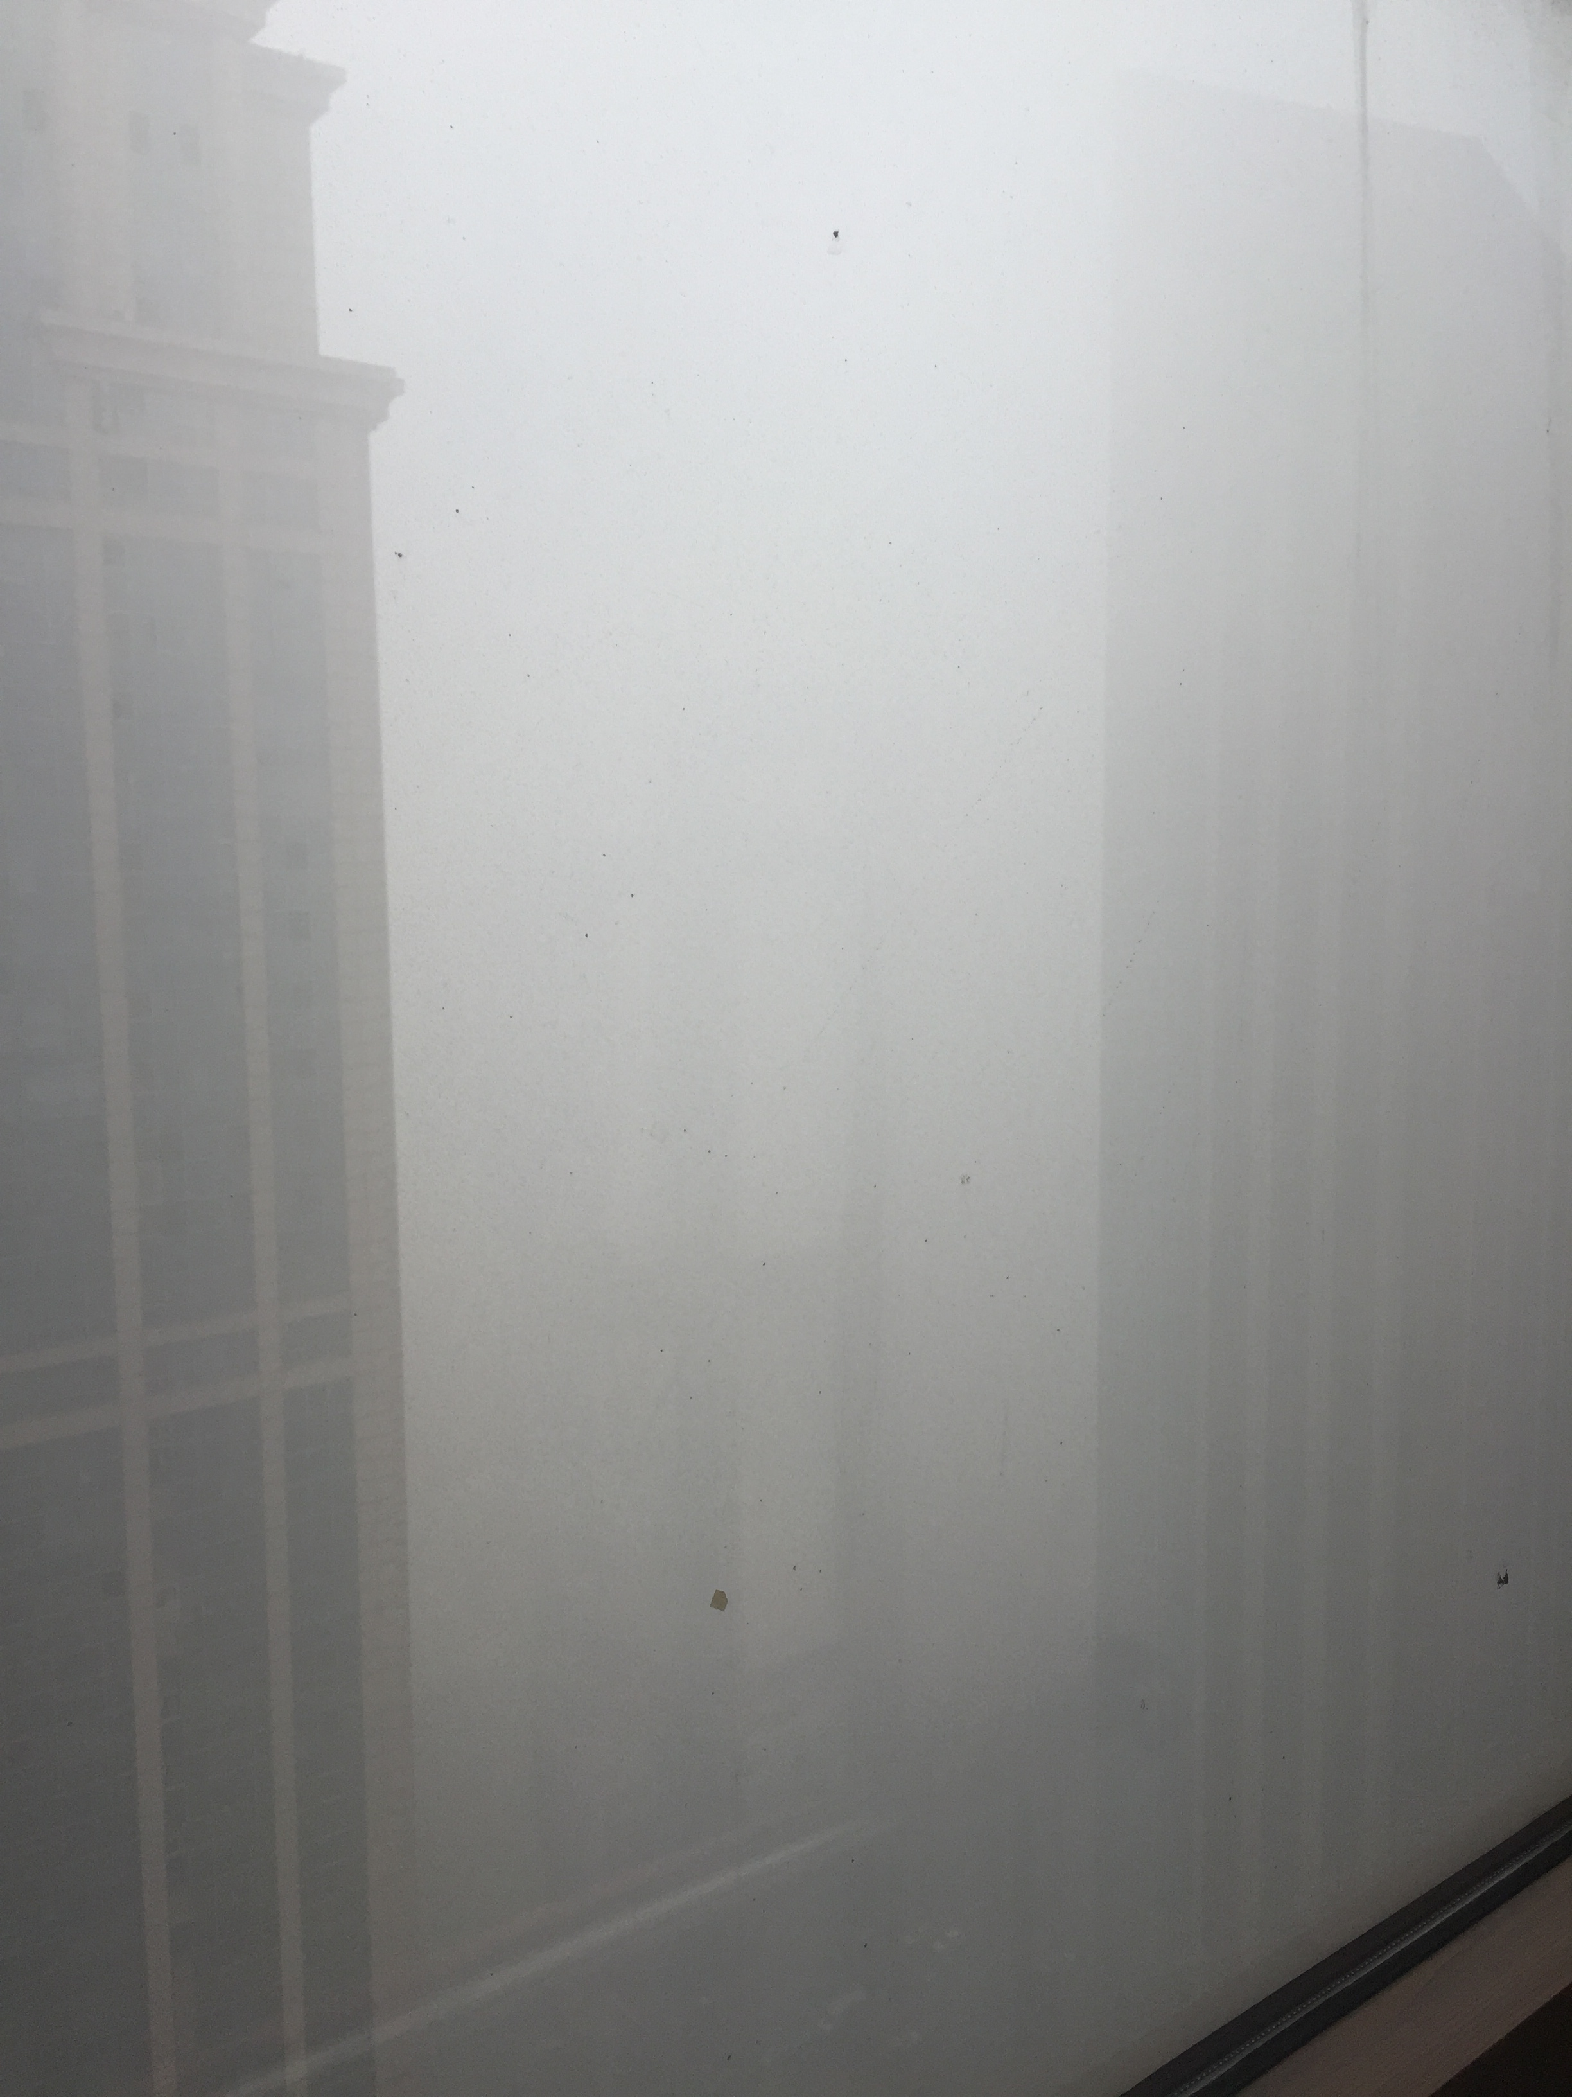

Dec 21st 2015
Tianjin, China
May 25th 2016
Tianjin, China

Slide 4
How can we solve the problem of air pollution?
ECON490: Environmental Economics

Slide 5
market failure: negative production externality
command and control policy
incentive based policy
Pigouvian tax is an incentive based policy

Slide 6
Pigouvian tax
Arthur Cecil Pigou
“the Economics of Welfare”
marginal private cost + tax = marginal social cost
market equilibrium = social efficient equilibrium
p
MPC + tax
MPC
D=MPB=MSB
Q
Qefficient
Qmarket

Slide 7
Outline
Pigouvian tax under perfect competition
Dennis and Glenn
Coase
Pigouvian tax under imperfect competition (monopoly)
Buchanan

Slide 8
Pigouvian tax under perfect competition
Dennis and Glenn:
Pigouvian tax works in the short run but is mathematically untenable in the long run.

Slide 9

Mathematical Analysis
Assumption: identical firms which produces homogeneous products
C(q): individual firm cost
q: output for individual firm
D(n,q): external damage
n: numbers of firms
In the short run:
Competitive equilibrium →P(nq)=C’(q)+t
Social optimum → P(nq)=C’(q)+$\frac{1}{n}\frac{∂D}{∂q}$(n,q)
t=$\frac{1}{n}\frac{∂D}{∂q}$(n,q*)

Slide 10

Mathematical Analysis
In the long run:
Competitive equilibrium →P(nq)=C’(q)+t
→qP(nq)=C(q)+tq
Social optimum → P(nq)=C’(q)+$\frac{1}{n}\frac{∂D}{∂q}$(n,q)
→ qP(nq)=C(q)+$\frac{∂D}{∂n}$(n,q)
t=??

Slide 11
Pigouvian tax under perfect competition
Coase:
Society will ultimately receive social optimum without government intervention and therefore any forms of correction like Pigouvian tax is distortive and shouldn’t be used.

Slide 12
confectioner vs. doctor
Limitations: property rights are identifiable
property rights are transferable
transaction costs are low
contracts are enforceable

Slide 13
Pigouvian tax under imperfect competition (monopoly)
Buchanan:
Pigouvian tax will further the misallocation of resources associated with the negative externality.

Slide 14
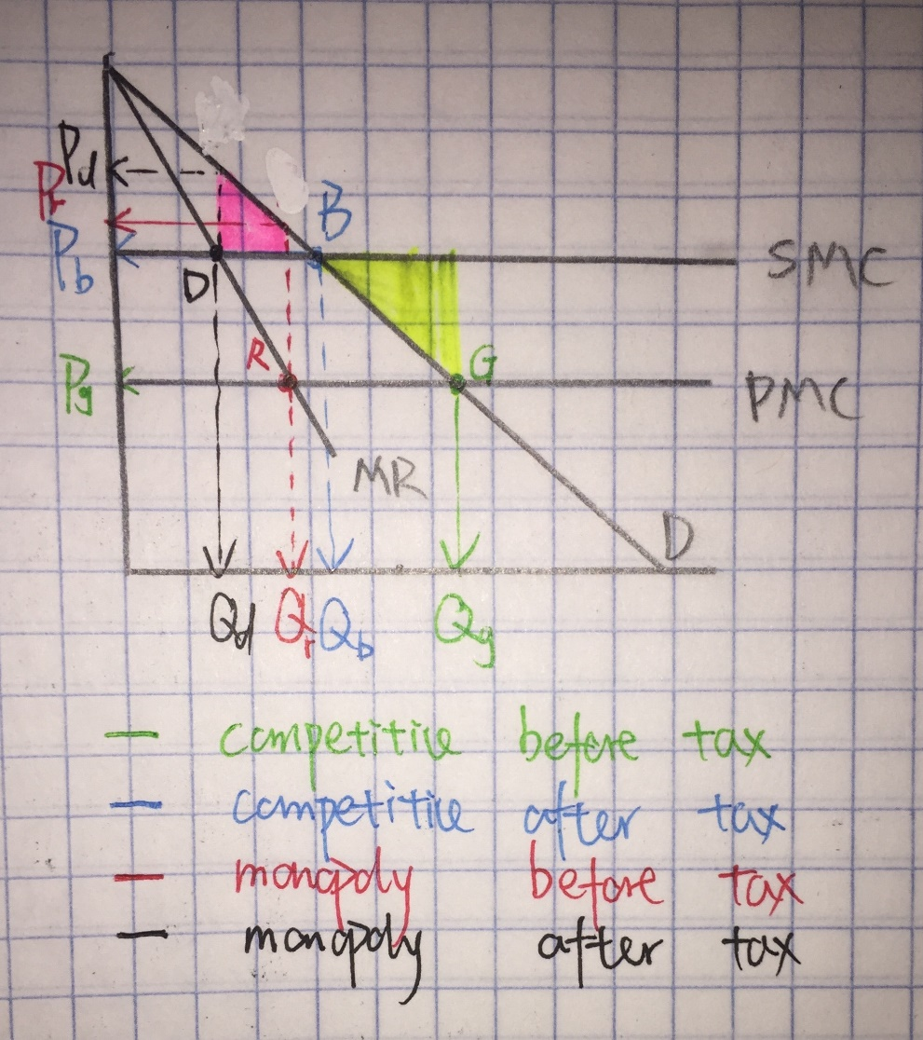
Mathematical Analysis

Slide 15
Conclusion
Solving the problem of air pollution is far complex than simply imposing the Pigouvian tax since people change their behaviors accordingly. And it is hard to predict human incentives and behaviors. Therefore, in order to either support the Pigouvian tax or oppose it, we need to find data to backup our statement.

Slide 16
Bibliography
Pigou, A.C. (1932). The Economics of Welfare (fourth edition), MacMillan, London.
Dennis W. Carlton and Glenn C. Loury (1980), “The Limitations of Pigouvian Taxes as a Long-Run remedy for Externalities”, The Quarterly Journal of Economics Vol. 95, No.3, 559-566
R. H. Coase(1960), “The Problem of Social Cost”, The Journal of Law and Economics, Vol.3
Buchanan, I.M. (1969), "External Diseconomies, Corrective Taxes and Market Structure", American Economic Review 59(1), 174-177.

