Slide 1
Observing Childcare Workers’ Socioeconomic Status
Huiyi Chen
Professor Elizabeth Powers
Department of Economics

Slide 2
Overview
Childcare workers earn little
  Median hourly wage 5% lowest in Illinois, 2015
    $10.5/hr
  730 occupations, rank #35 in hourly wage low-high
What do they do?
  Licensed, homecare & daycare center
Why?
  Gender
  Flexibility
  Education?
  Skill requirement?

Slide 3
Rationale
To find out the flexibility & demographics of childcare workers…
A group of controlled variables
  10 other occupations w/ similar…
    Wages
    Number of workers
  Years
  Geography
Other omitted variables?

Slide 4
Assumptions
The nature of childcare workers
  A women’s job
    Caretakers
    Trade wages with flexibility
  Low skilled?
Part-time > full-time
Lower educational attainment

Slide 5
Data
The Occupational Employment Statistics (OES)
  Bureau of Labor Statistics, yearly base
  Employment, median/mean wage, percentile
The American Community Survey (ACS)
  U.S. Census Bureau, yearly base
  Household & individual
  Work hours, demographics, education, etc.

Slide 6
Methodology
Access the OES data
  Find 12 occupations with median hourly wage less than 1 sd away from the median
  Similar employment
  A trend on 12 occupations’ median wages 1997-2015

Slide 7
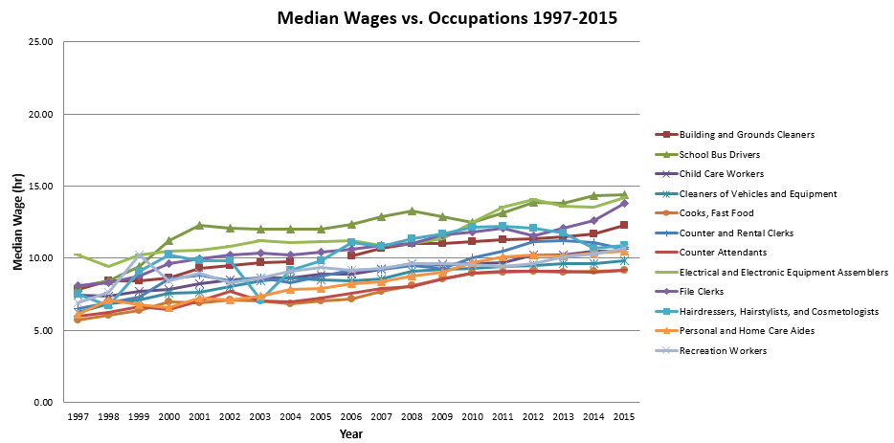
The OES Data

Slide 8
Methodology Con.
Access the ACS data
  Flexibility of work
    Part-time full year/part year, full-time full year/part year
  Gender distribution
  10 occupations

Slide 9
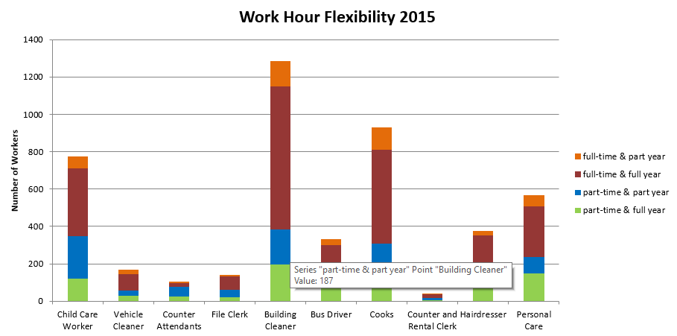
Flexibility 2015

Slide 10
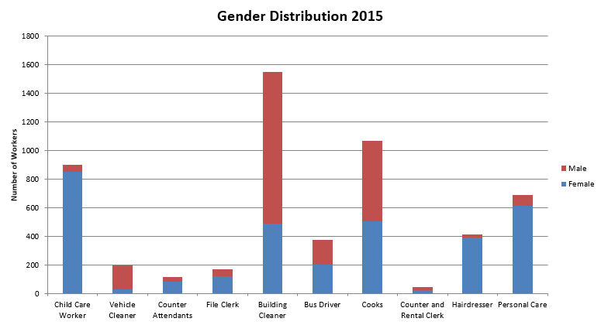
Gender Distribution 2015

Slide 11
Conclusion/Next Steps
Childcare workers in Illinois have relatively higher flexibility of work
Childcare a relatively higher female distribution
Questions
  Do women tend to trade flexibility with wages?
  Other variables to look at: education, # of children, age, race etc.

