Slide 1


Internet, competitive advantage and manufacturing upgrading
(Work in progress)
Hesong Yang
University of Illinois at Urbana-Champaign
Yabin Bian
Shandong University of Finance and Economics

Slide 2
Introduction
Background Information
Potential problems with the high rate of economic growth from the perspective of industrial chain
In recent years, manufacturing growth is slowing more quickly than overall economic growth
Industrial policy from Central Government in Beijing, searching new growth point
Sophistication of consumer’s demand
Research questions
How manufacturing firms can reinvent their competitive advantages in the upstream, midstream and downstream of industry chain through Internet integration?
With new competitive edges, how these firms can realize the growth and redistribution of value-added products?
How ‘Smiling Curve’ would respond to this process?

Slide 3
Literature Search
The situation of China’s economic conditions and Industrial Policy from central government
‘Smiling Curve’ Theory – manufacturing upgrading
Criticism about ‘Smiling Curve’ Theory
Impact of technological change on behaviors of both firm and consumer
Cases of some pioneer companies that introduce the concept of Industrial Internet

Slide 4
Key components
Internet
Competitive advantage
Value-added product
Modification of ‘Smiling Curve’

Slide 5
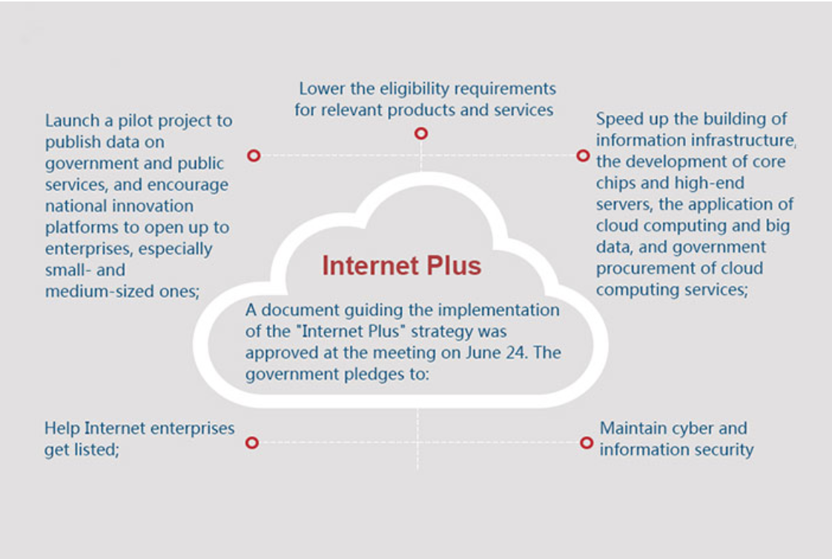
Internet plus
Source: http://english. gov.cn/2016special/internetplus/

Slide 6
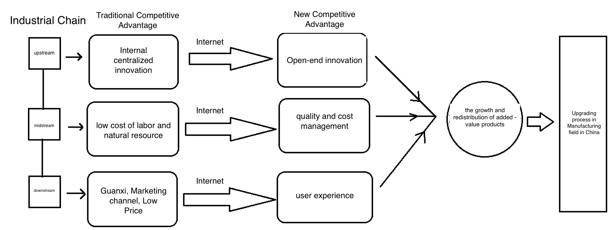
Competitive Advantage

Slide 7
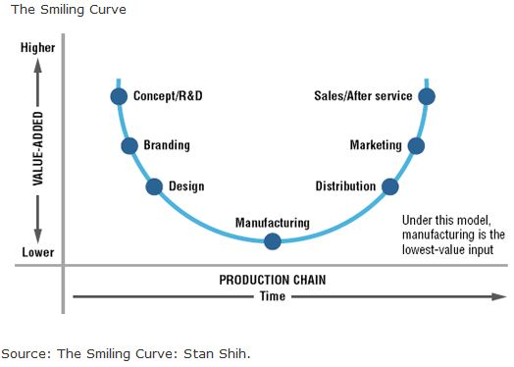
Smiling Curve

Slide 8
Modification of Smiling Curve
Assumptions:
Internet encourages enterprises to form new competitive edges with the external ideas from their customers
New competitive advantages can increase Value-added product
They can also change the distribution pattern of VAP
The change of both growth and distribution patterns of VAP could promote industrial upgrading process in China

Slide 9
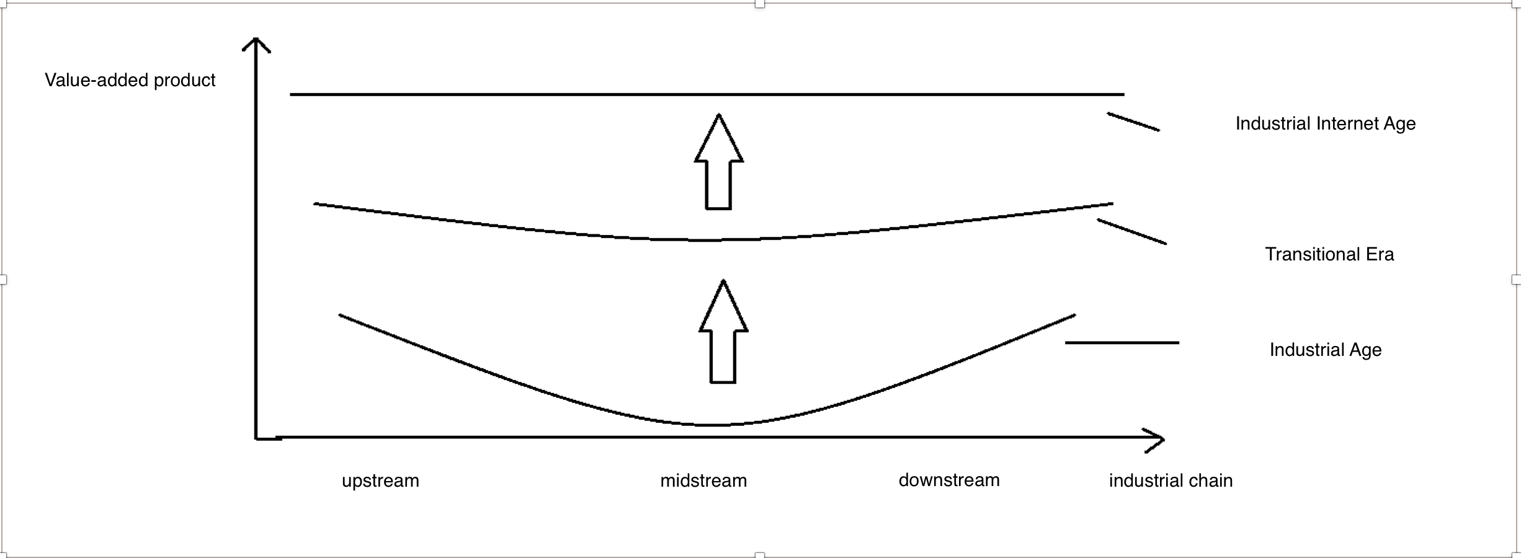
Modification of Smiling Curve

Slide 10
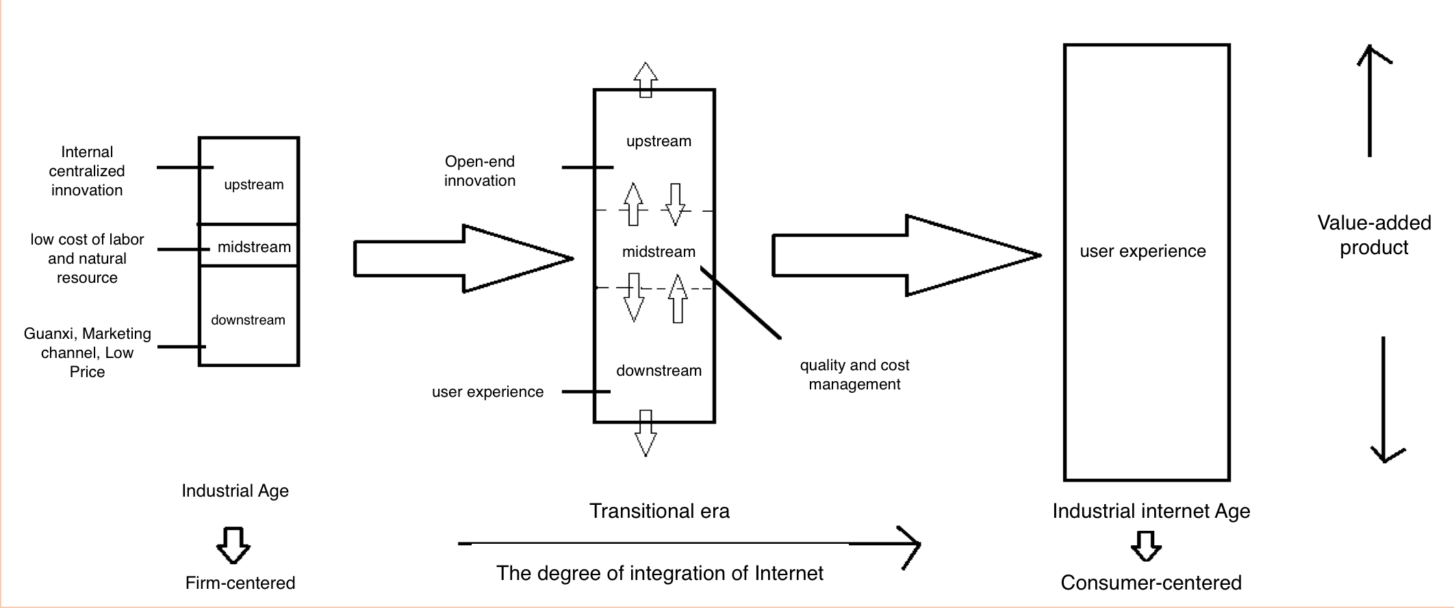
Mechanism that drives this modification

Slide 11

Inspiration: law of Communicating Vessel in Physics

Slide 12
Next Steps
Choose specific industry and companies in manufacturing field
Learn more in depth about how this policy is implemented in this industry
Data and indicator system
Model
Econometric analysis
Modify theory

Slide 13
Works Cited
Beal. D & E. R . Sabater. （2015）. Why Well-being Should Drive Growth Strategies. BCG.
Collier , P & J . Page. （ 2011）. Industrial Development Report 2009. UNIDO.
Eloot , K., Huang, A., Lehnich, M. (2013). A new era for manufacturing in China. Mckinsey Company.
McKinsey Global Institute. （1998). Big Data-The Next Frontier For Innovation, Competition And Productivity. Mckinsey Company.
Porter , M. （2015）. How Smart, Connected Products Are Transforming Competition. Harvard Business Review.

